Slide 1
Big Data Technology
Tweet Analyzer

Slide 2
Final Project
- For the Requirement of BDT Course
Submitted To: Prof. Mrudula Mukadam
Submitted By:
Usama Karam
Usman Haider
Safwan Shoukat Abbasi
Amrit Raj Sagar

Slide 3
Technologies Used
CentOS Version 6.7
Hadoop Version 2.6.0
Java JDK & JRE Version 8
Eclipse Version LUNA 4.4.2
Kafka Version 2.11-1.1.0
HBase Version 1.2.0
Hive Version 1.1.0
Spark Version 1.6.0
Tableau Version 2021.4.6

Slide 4
Project Overview
We used Volume Sample Tweet Streaming API for our project to get the tweets from Twitter for further aggregation, filter and analysis.
Kafka Messaging tool is used for storing the tweets in kafka using topic created(“tweet-topic”)
Spark Streaming is used for getting the tweets from kafka and performing some filter and aggregation so that the structured tweet are saved to HBase Table
Spark SQL is used to perform some analysis over stored data in HBase and then further store the result to HDFS
HIVE External Table is created over HDFS to perform visualization of the result
Tableau Desktop is used for result visualization

Slide 5
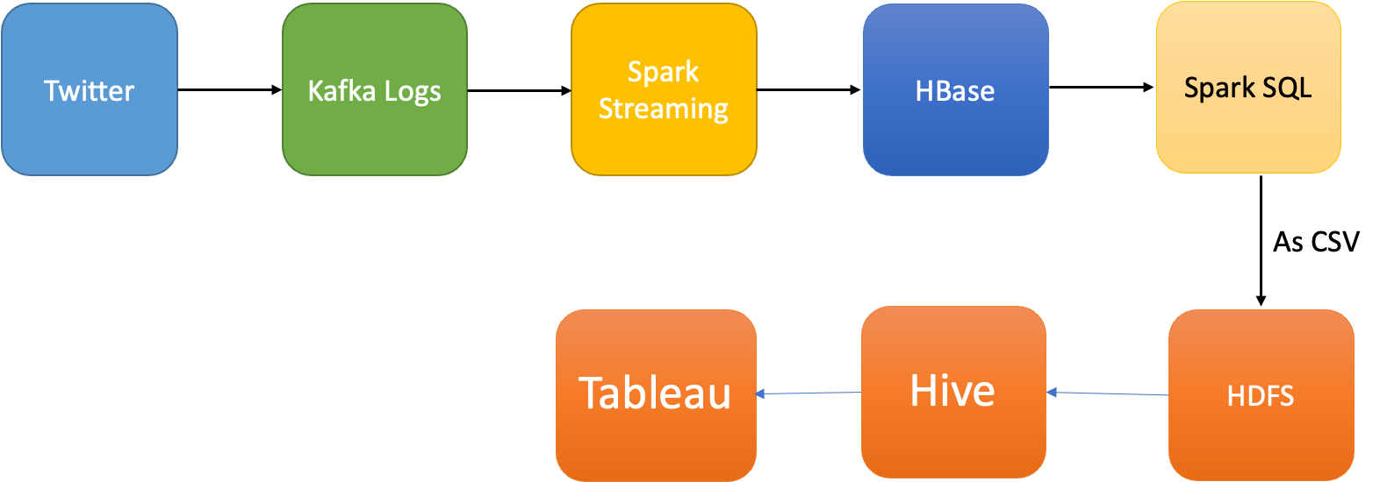
Project Big Picture
Notes:
1.First we will get the data from twitter and store it in the Kafka Logs
2.Now from Kafka logs, we will use Spark Streaming to store the data in the HBase tables(Perform some aggregation)
3.Now we will read the data stored in Hbase table and using Spark SQL we will store the it HDFS.
4.Now we will create External Hive table using location where the csv file stored in HDFS
5.Now connect Hive to Tableau and visualize.

Slide 6
Big Picture in Detail
Twitter Kafka Producer
Getting “tweets” from Twitter using API
We used Bearer token provided by twitter for getting the tweets from API
We used “Volume Stream GET API “https://api.twitter.com/2/tweets/sample/stream” for streaming tweets
Connected to Kafka topic which we created from terminal and send tweets to Kafka topic

Slide 7
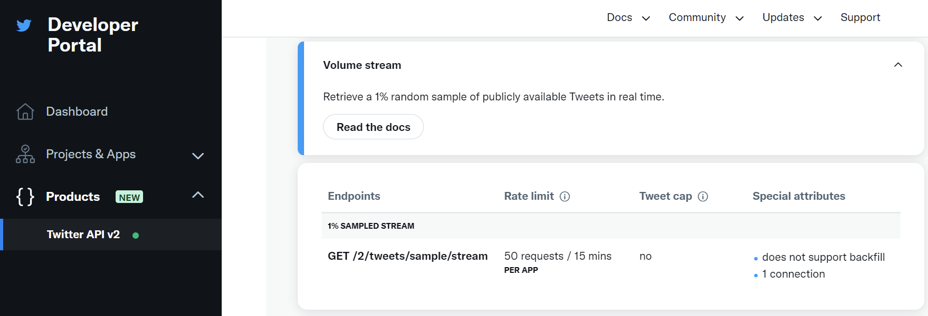
API Used from Twitter

Slide 8
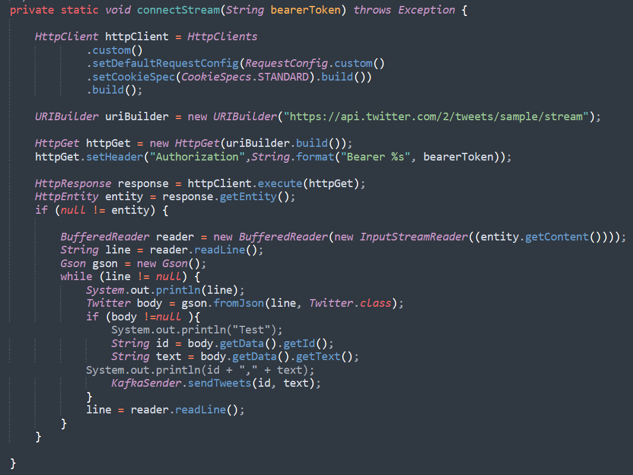
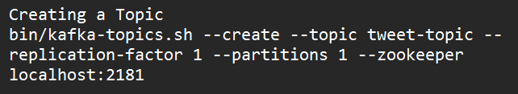
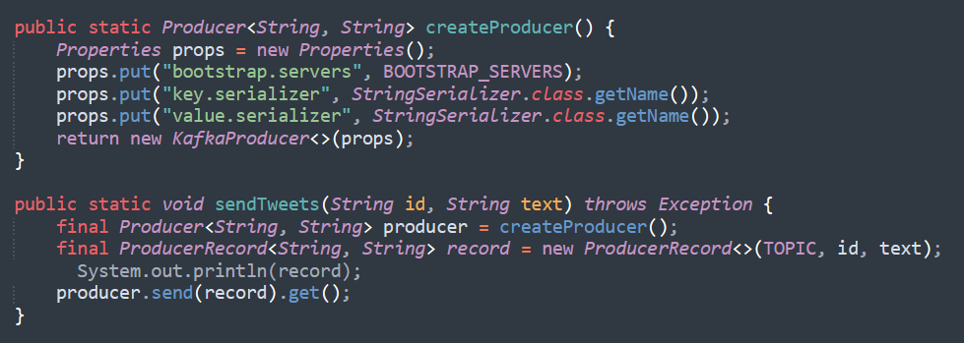
Connect Twitter and Send tweets to Kafka

Slide 9
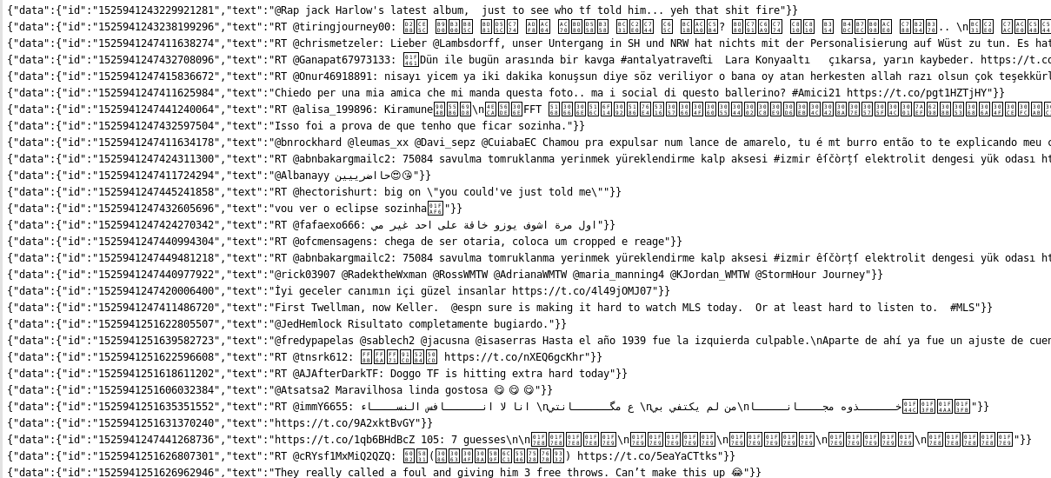
Connect Twitter and Send tweets to Kafka Cont’d…

Slide 10
Big Picture in Detail
Spark Streaming Kafka Consumer
Receive tweets from kafka and pass to Spark
Spark aggregate and filter tweets by keyword defined in HBase Table.
Spark store aggregated/filtered tweets into HBase Table

Slide 11
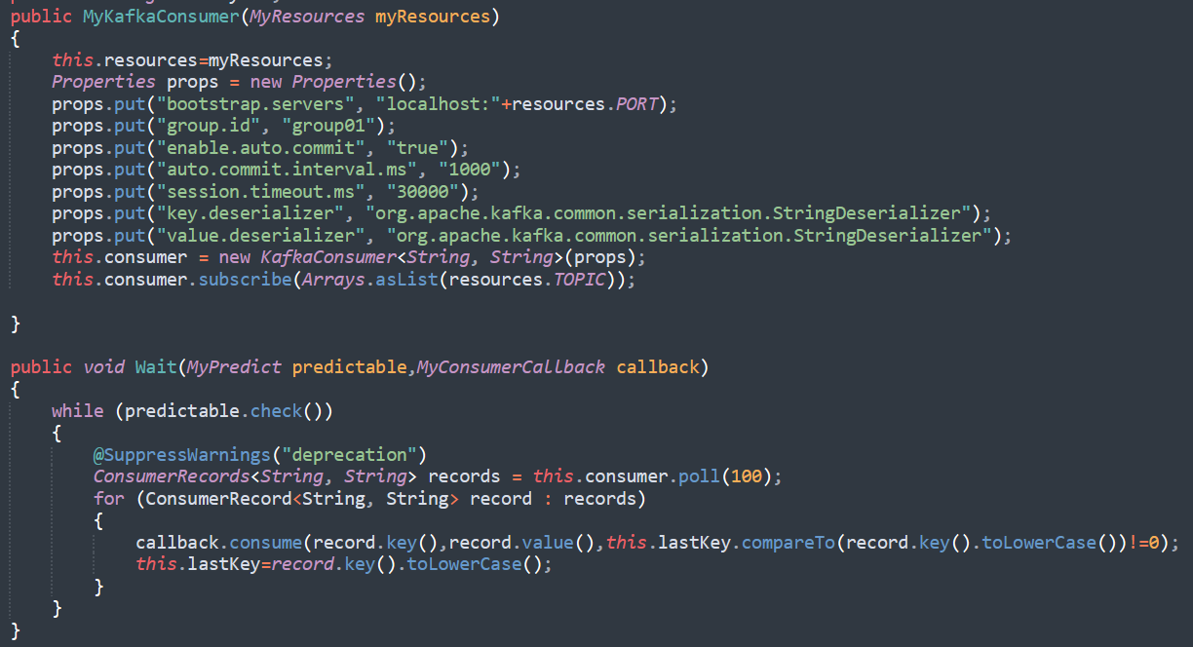
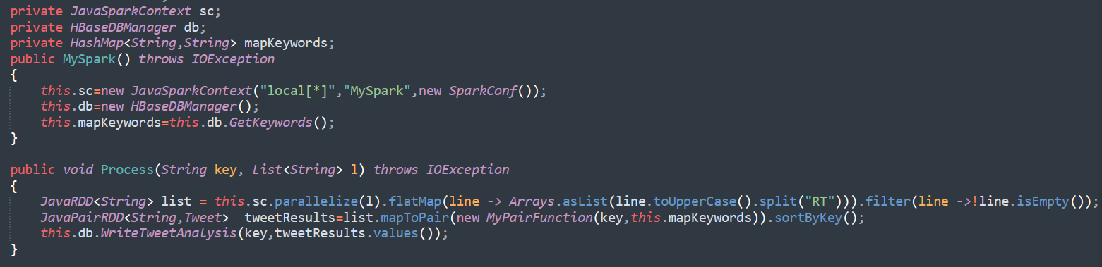
Spark Streaming from Kafka to HBase

Slide 12
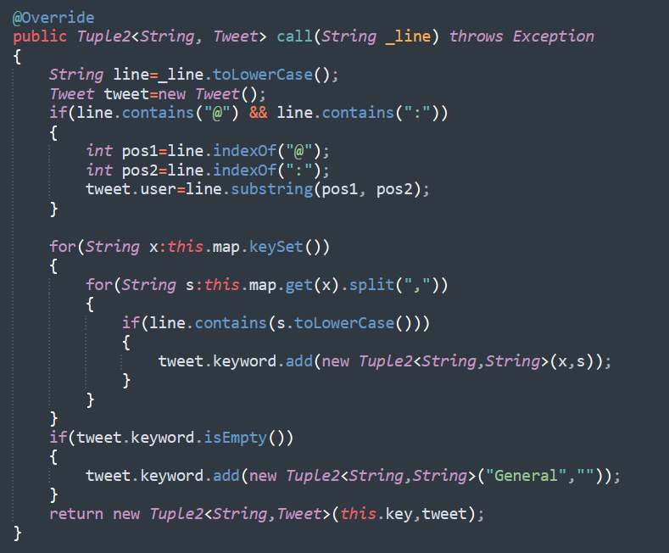
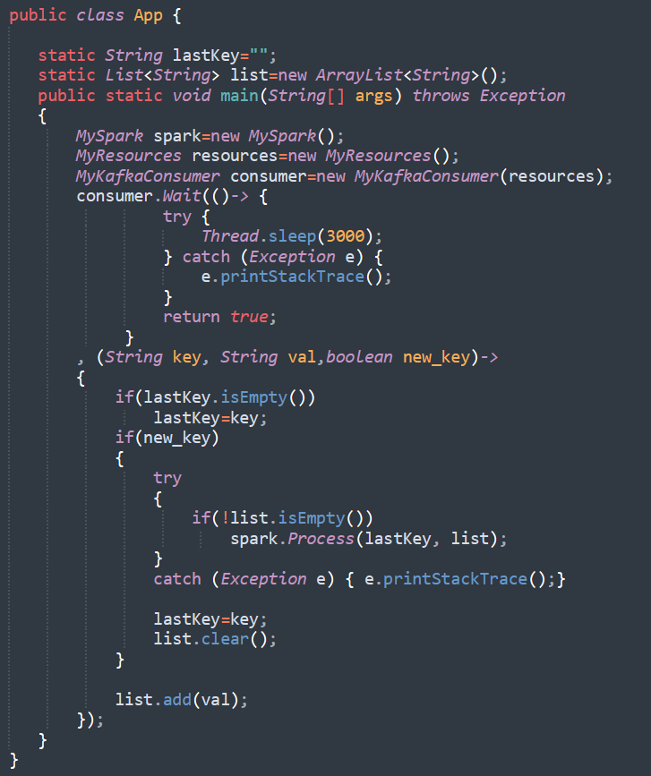
Spark Streaming from Kafka to HBase Cont’d…

Slide 13
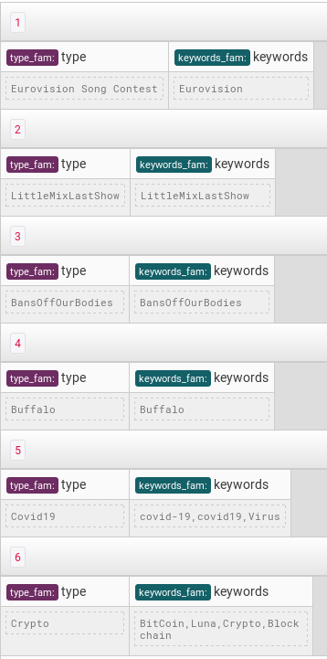
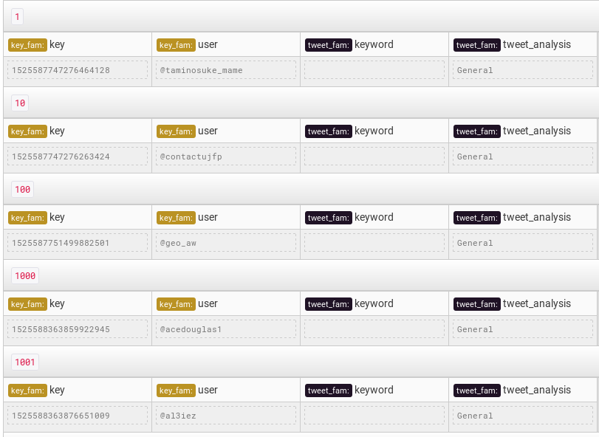
Spark Streaming from Kafka to HBase Cont’d…

Slide 14
Big Picture in Detail
Spark SQL
Get stored data from HBase Table and perform some Spark SQL queries, like grouping by keywords, counts, etc.
Write the results as CSV file to HDFS and consume it by creating External Hive Table

Slide 15
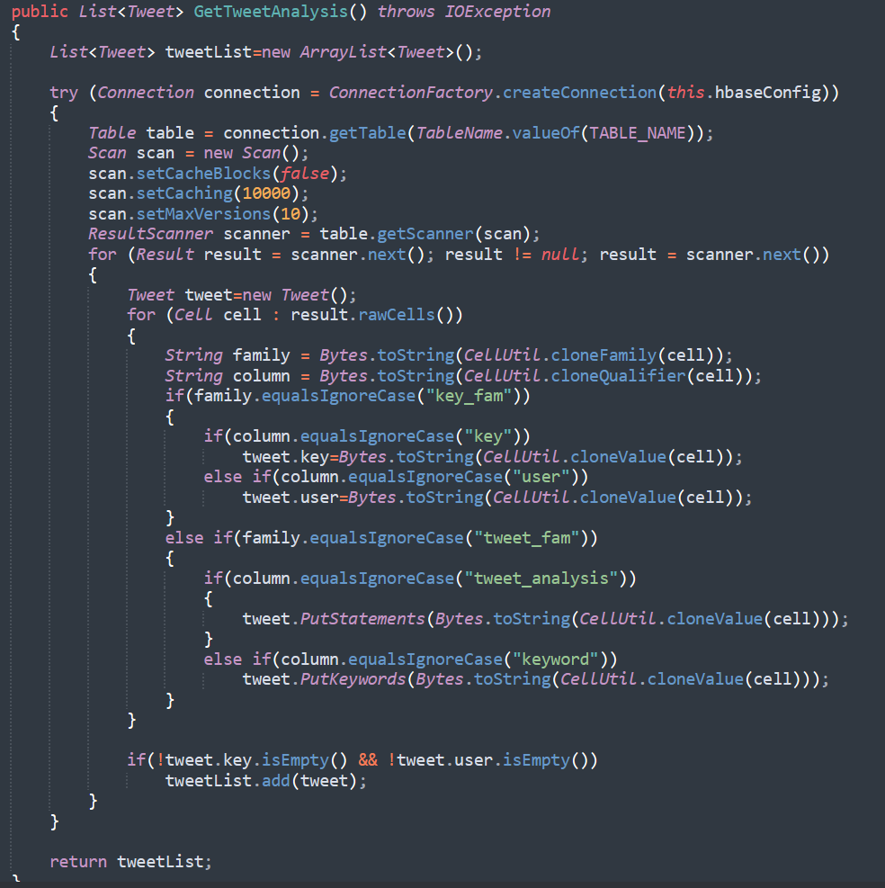
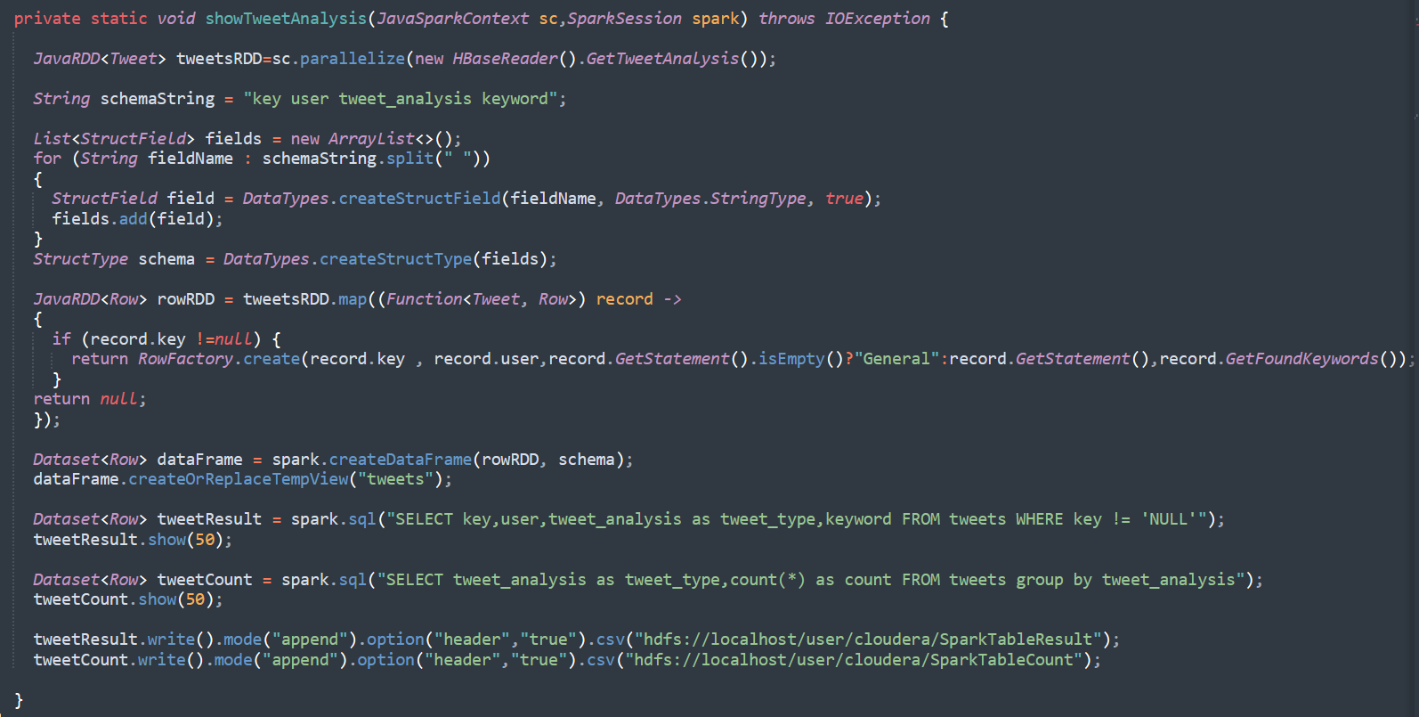
Spark SQL from HBase to HDFS

Slide 16
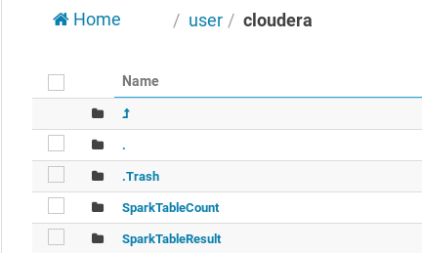
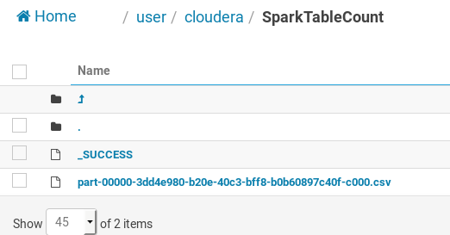
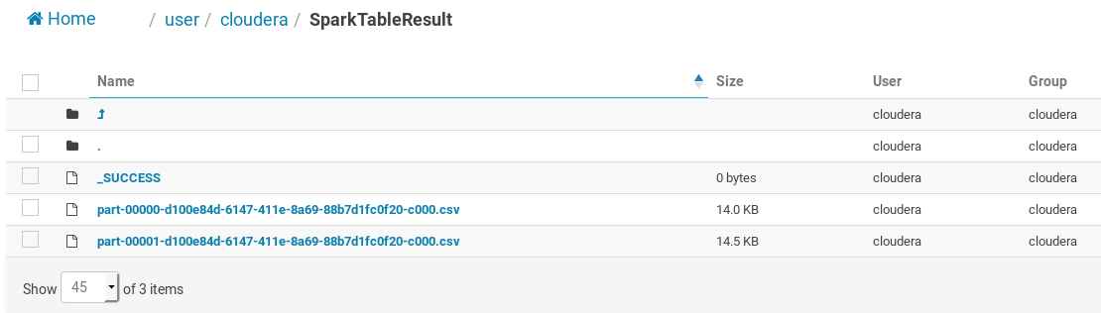
Spark SQL from HBase to HDFS Cont’d…

Slide 17
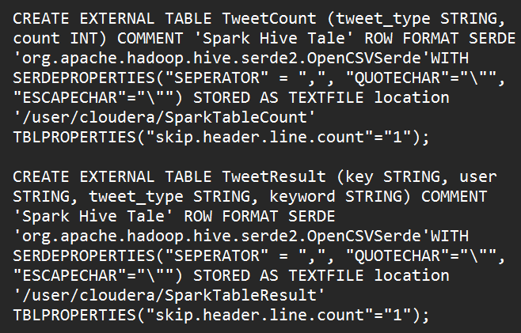
Big Picture in Detail
Hive Table
Create External Hive table using shell command
The data stored in HDFS location as CSV file

Slide 18
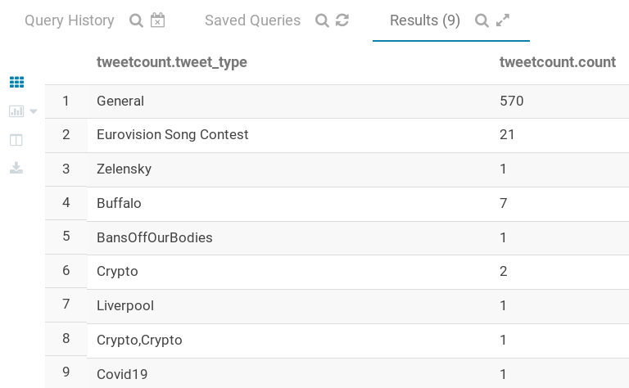
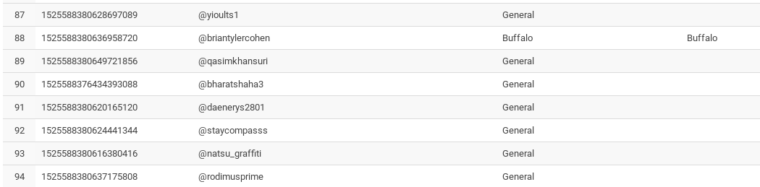
Hive Table Cont’d…

Slide 19
Big Picture in Detail
Tableau
Connect Tableau with Cloudera Hadoop using ODBC client
Fetch data from the Hive Tables
Visualize the data in the forms of Pie Chart or Bar Graph
We may perform other analysis on Tableau also

Slide 20
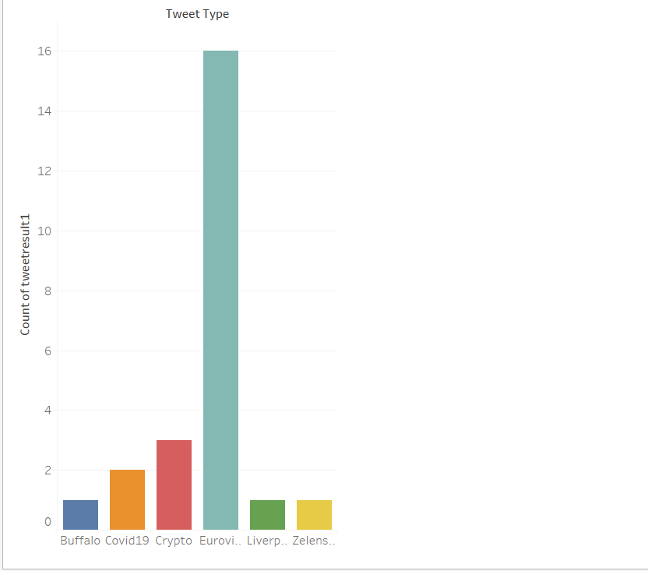
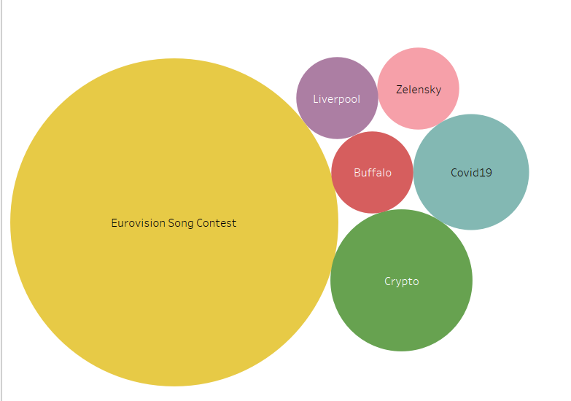
Tableau Visualization

Slide 21
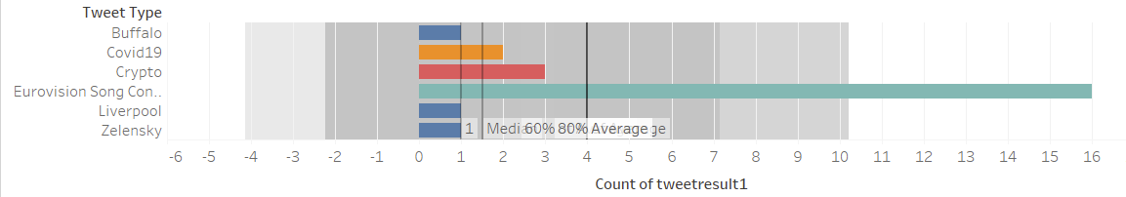
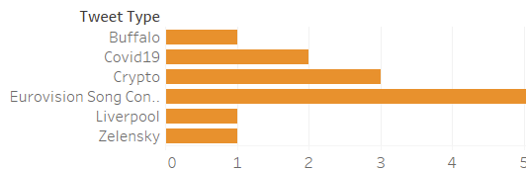
Tableau Visualization Cont’d…

Slide 22
Big Picture Breakdown - Demo Steps
Step # 01:
Created a twitter developer account (https://developer.twitter.com)
Changed access level to “Elevated” to get 2M tweets per month(In Normal mode only 500K tweets per month is accessible)
Generated following Keys
Bearer Token
API Key
API Key Secret

Slide 23
Big Picture Breakdown - Demo Steps Cont’d...
Step # 02:
Download Kafka from https://archive.apache.org/dist/kafka/
Extract at any location i.e. /home/cloudera/Desktop/kafka_2.11-1.1.0
Run Zookeeper using command “bin/zookeeper-server-start.sh config/zookeeper.properties”
Run Kafka Server using command “bin/kafka-server-start.sh config/server.properties”
Create Topic using command “bin/kafka-topics.sh --create --topic tweet-topic --replication-factor 1 --partitions 1 --zookeeper localhost:2181”
Notes:
Notes:
If zookeeper is already running in the VM then skip the 3rd Step
To view all listed topic in Kafka use command List bin/kafka-topics.sh --list --zookeeper localhost:2181
To describe topic use bin/kafka-topics.sh --zookeeper localhost:2181 --describe --topic tweet-topic
To delete a topic use bin/kafka-topics.sh --zookeeper localhost:2181 --delete --topic tweet-topic

Slide 24
Big Picture Breakdown - Demo Steps Cont’d...
Step # 03:
Run the Twitter Kafka Producer Application
It to fetches tweets from twitter, this can be seen on console
Step # 04:
Run the Spark Kafka Application(Spark Streaming) and the tweets are stored in HBase Table after aggregation/filter
Step # 05:
Run the Spark SQL Application and store the tweets in HDFS in the form of CSV Files
Notes:
Notes:

Slide 25
Big Picture Breakdown - Demo Steps Cont’d...
Step # 06:
Create the External HIVE table by using the CSV Files stored in HDFS
Step # 07:
Connect the Tableau with Cloudera Hadoop using ODBC Driver
Step # 08:
Fetch data from HIVE table and show it in the Pie Chart or Bar Graph
Notes:
Notes:

Slide 26
Wholeness of Project
In this project we have used multiple technologies such as Kafka, Spark, Hive, Tableau, etc. to get the tweets from twitter and perform some analysis on it. After analysis we have visualized the results into Pie Chart and Bar Graph.
Science and Technology of Consciousness: As creation is built up of layers and to get to know about unified field of consciousness, we practice Transcendental Meditation on daily basis. After practicing the Transcendental Meditation, we get to visualize the positive effects of it in our daily lives and often times nature is coming for the help as well.
Notes:
Notes:

Slide 27

Notes:
Notes:

Slide 28


